Slide 1
Introduction to Raspberry Pi and Linux workshop
At SUTD
14 March 2015
By: Yeo Kheng Meng (yeokm1@gmail.com)
https://github.com/yeokm1/intro-to-rpi

Slide 2
Components check
Raspberry Pi Model B
Micro-SD card
Micro-USB cable ( with power adapter)
Small Breadboard
LED
Push button
220-ohm Resistor
4 male-female jumper wires
LAN cable

Slide 3
Download SSH client
Windows: Download Putty
Linux/Mac: Includes SSH client by default

Slide 4
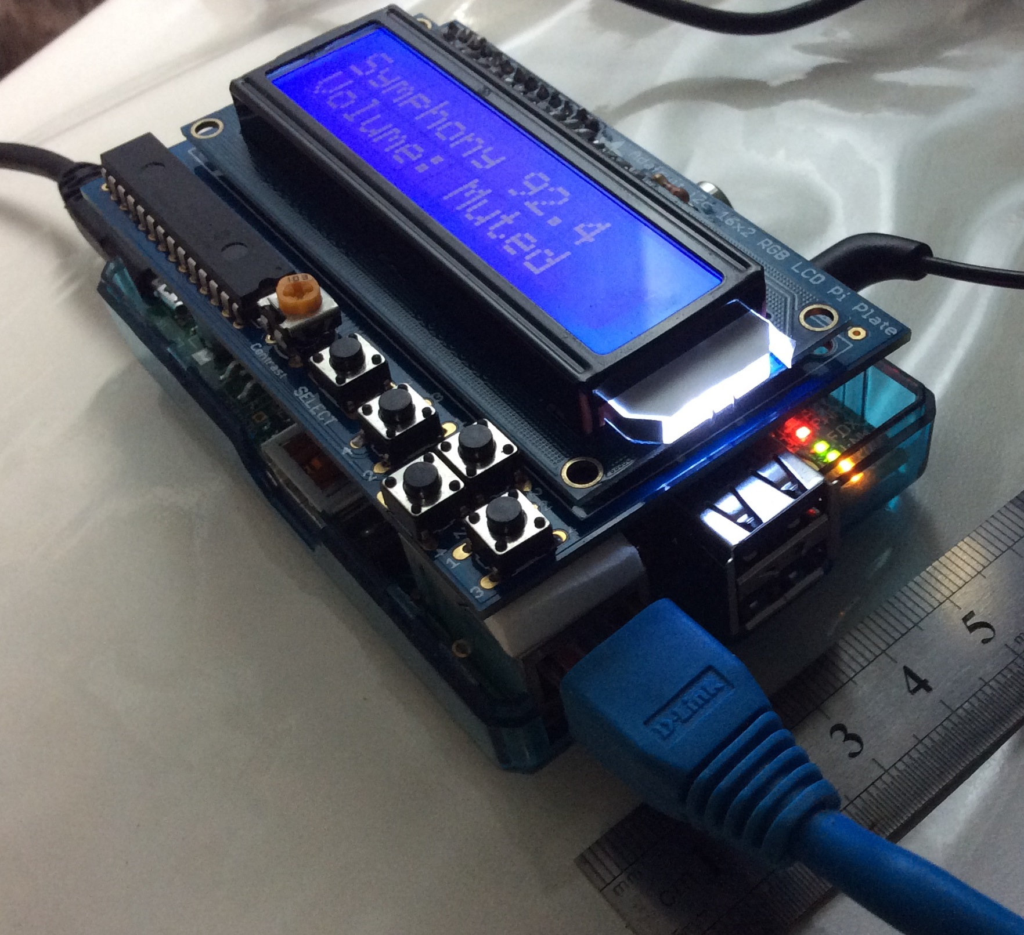
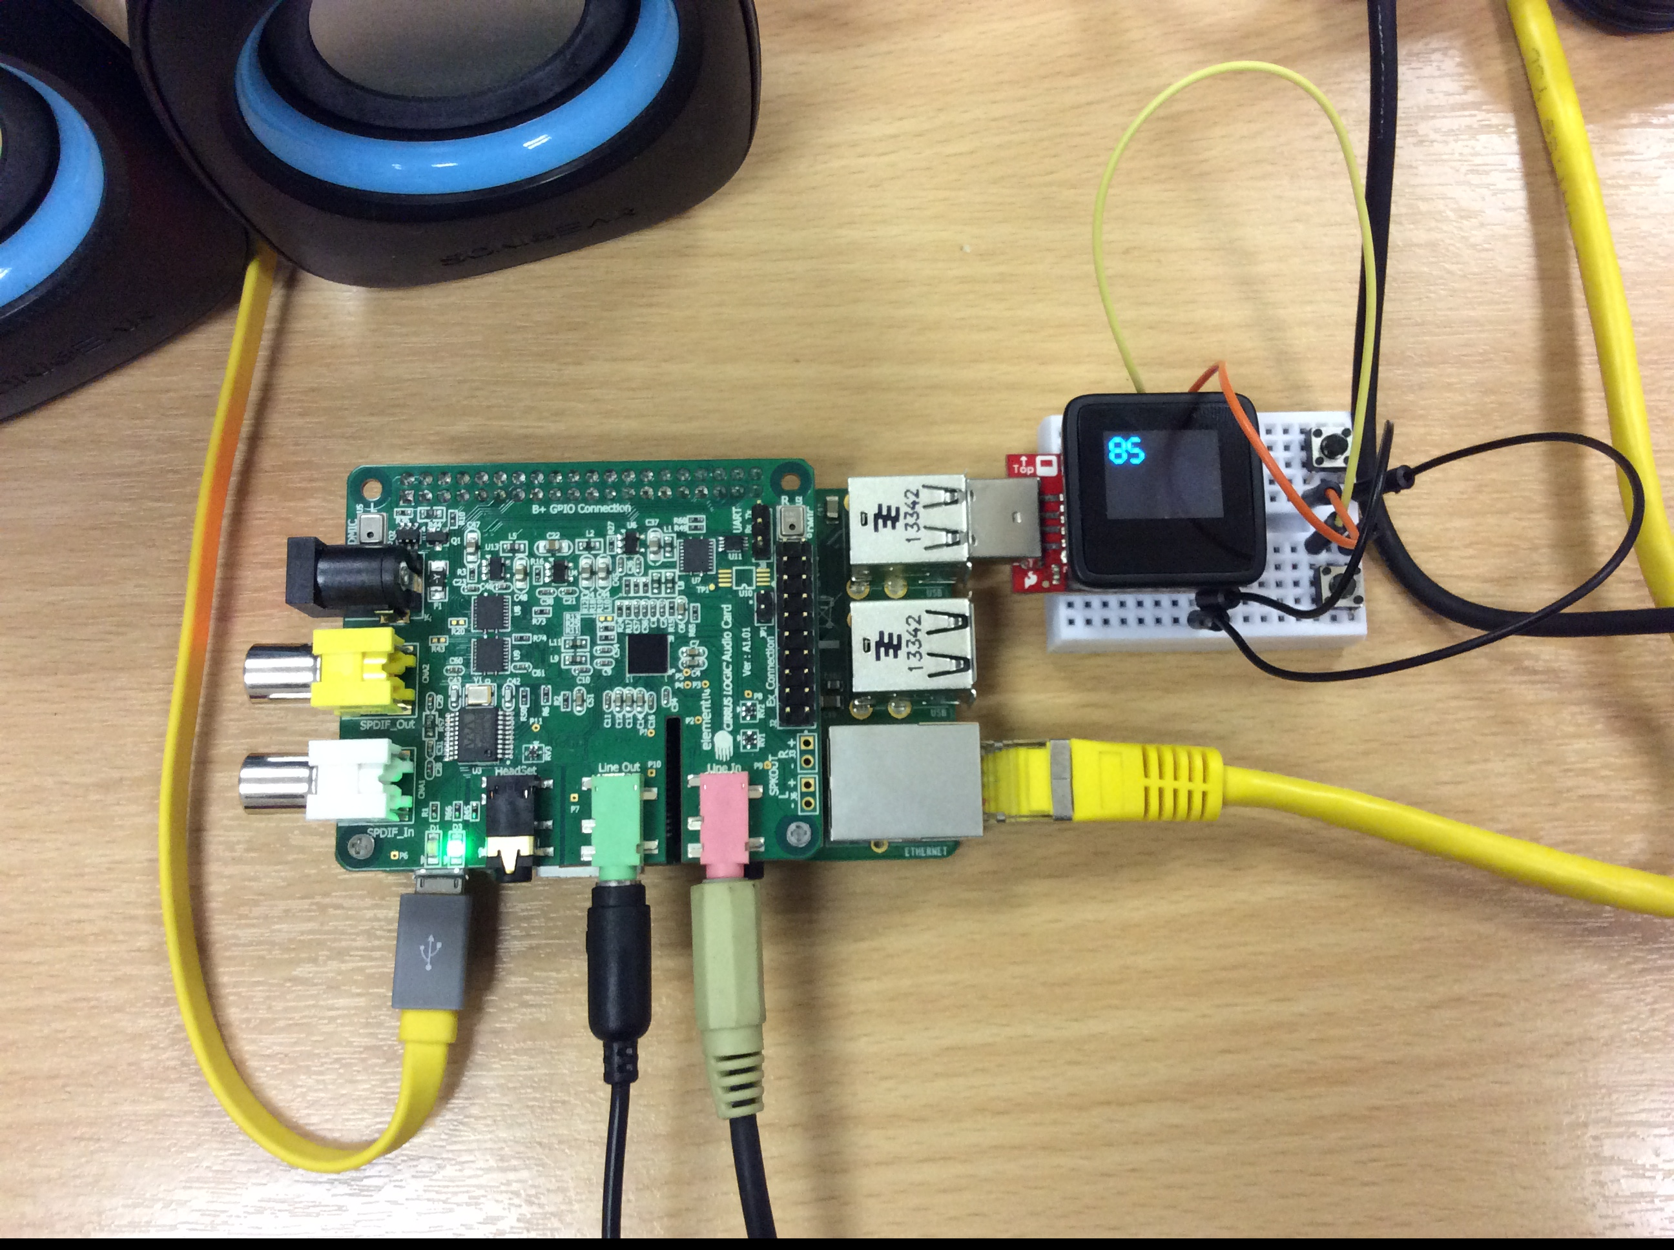
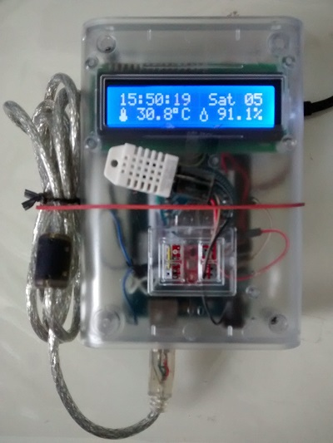
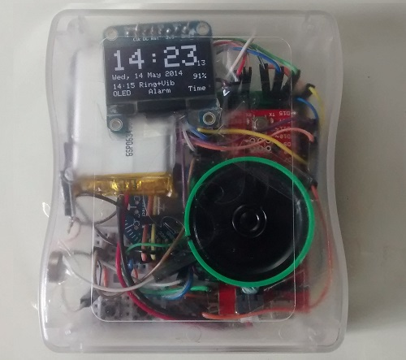
About me
Year 4 NUS Computer Science student
My Hardware projects with Arduino and Raspberry Pi

Slide 5
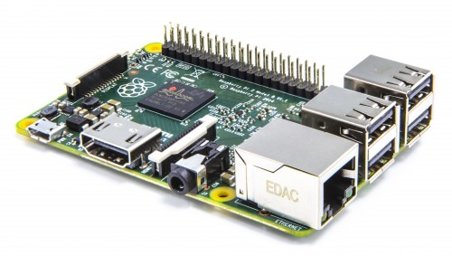
What is a Raspberry Pi (RPi)?
“The Raspberry Pi is a low cost, credit-card sized computer that plugs into a computer monitor or TV, and uses a standard keyboard and mouse. It is a capable little device that enables people of all ages to explore computing, and to learn how to program in languages like Scratch and Python. It’s capable of doing everything you’d expect a desktop computer to do, from browsing the internet and playing high-definition video, to making spreadsheets, word-processing, and playing games.” http://www.raspberrypi.org/help/what-is-a-raspberry-pi/

Slide 6
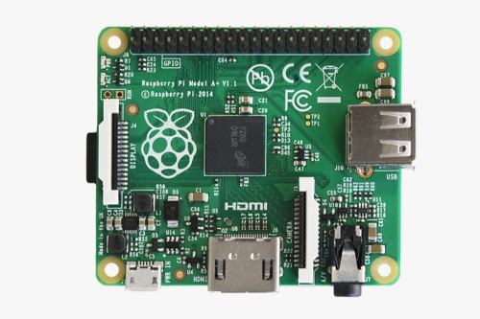
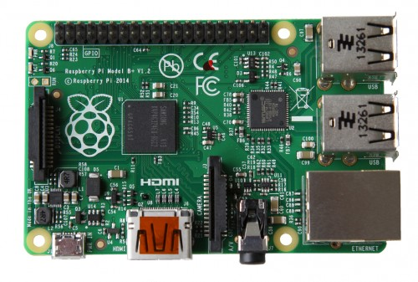
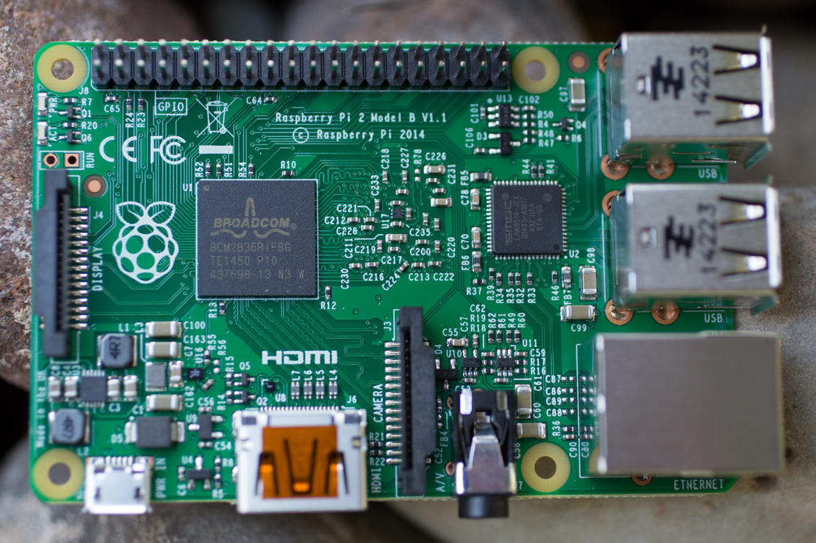
Common Rpi types today
Model A+
Model B+
2 Model B
700Mhz single-core ARMv6
256MB Ram
1 USB port
No Ethernet port
700Mhz single-core ARMv6
512MB RAM
4 USB ports
Ethernet port
900Mhz quad-core ARMv7
1024MB Ram
4 USB ports
Ethernet port
Power use:
Source: http://raspi.tv/2015/raspberry-pi2-power-and-performance-measurement

Slide 7
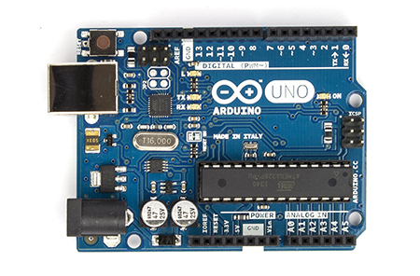

Arduino vs Raspberry Pi
Specs | Arduino Uno | Raspberry Pi Model B+
CPU type | Microcontroller | Microprocessor
Operating System | None | Linux (usually Raspbian)
Speed | 16 Mhz | 700 Mhz
RAM | 2KB | 512MB
GPU/Display | None | VideoCore IV GPU
Disk | 32KB | Depends on SD card
GPIO pins | 14 digital pins (includes 6 analog) | 26 digital pins
Other connectivity | None | USB, Ethernet, HDMI, audio
Power consumption | 0.25W | 3.5W

Slide 8
What is an Operating System (OS)?
An operating system (OS) is software that manages computer hardware and software resources and provides common services for computer programs.
Source: http://en.wikipedia.org/wiki/Operating_system
My definition:
A giant piece of software that gives programs you download/write hardware features in a standardised manner.
Closed-source vs open-source
Closed: Windows, Mac OS X
Open: Linux, FreeBSD, FreeDOS
Unix(-like) vs non-Unix
Unix: Linux, Mac OS X
Non-Unix: Windows

Slide 9
Powering up your Raspberry Pi
Connect the following first
SD card
HDMI cable
Keyboard/mouse
Connect this last
Micro-USB cable

Slide 10
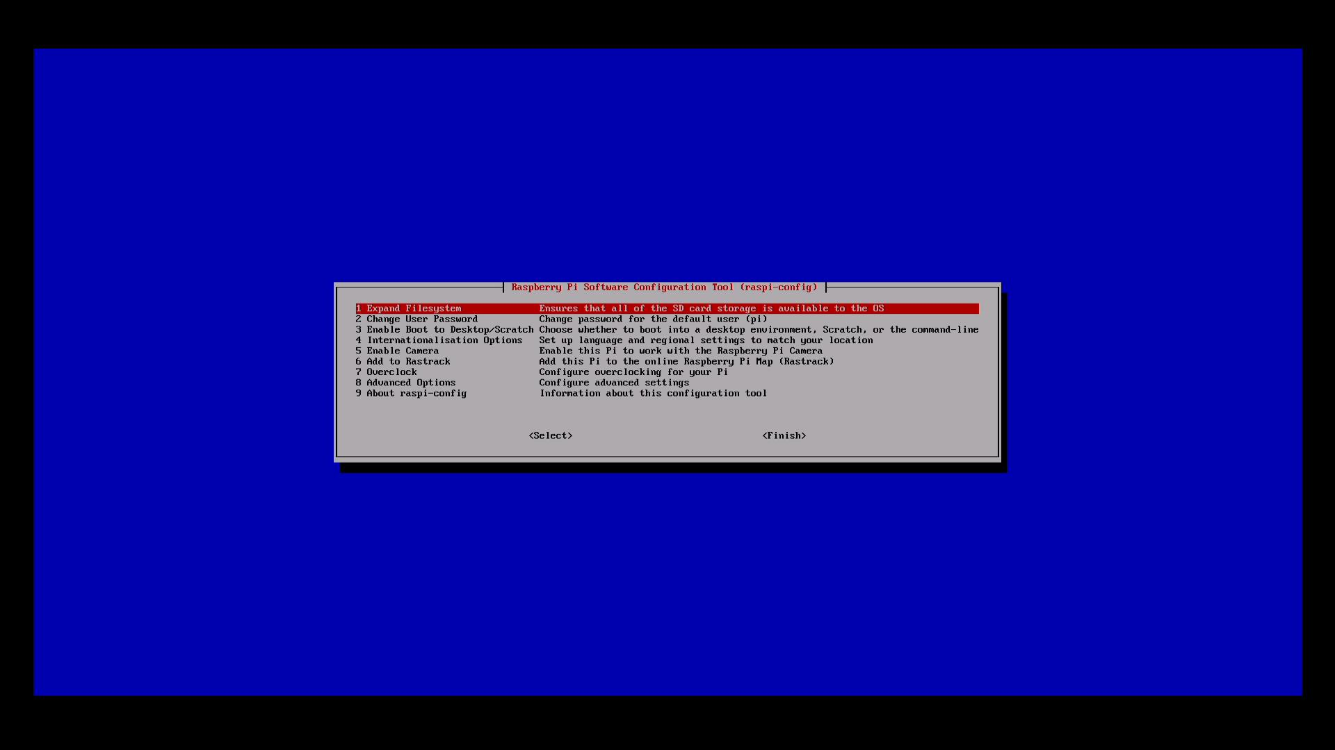
First boot/Setup with raspi-config

Slide 11
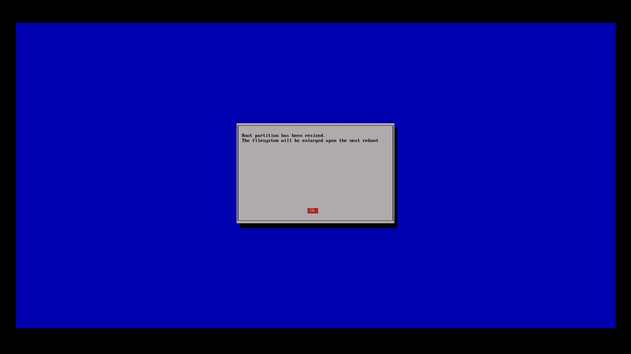
Enlarge root partition

Slide 12
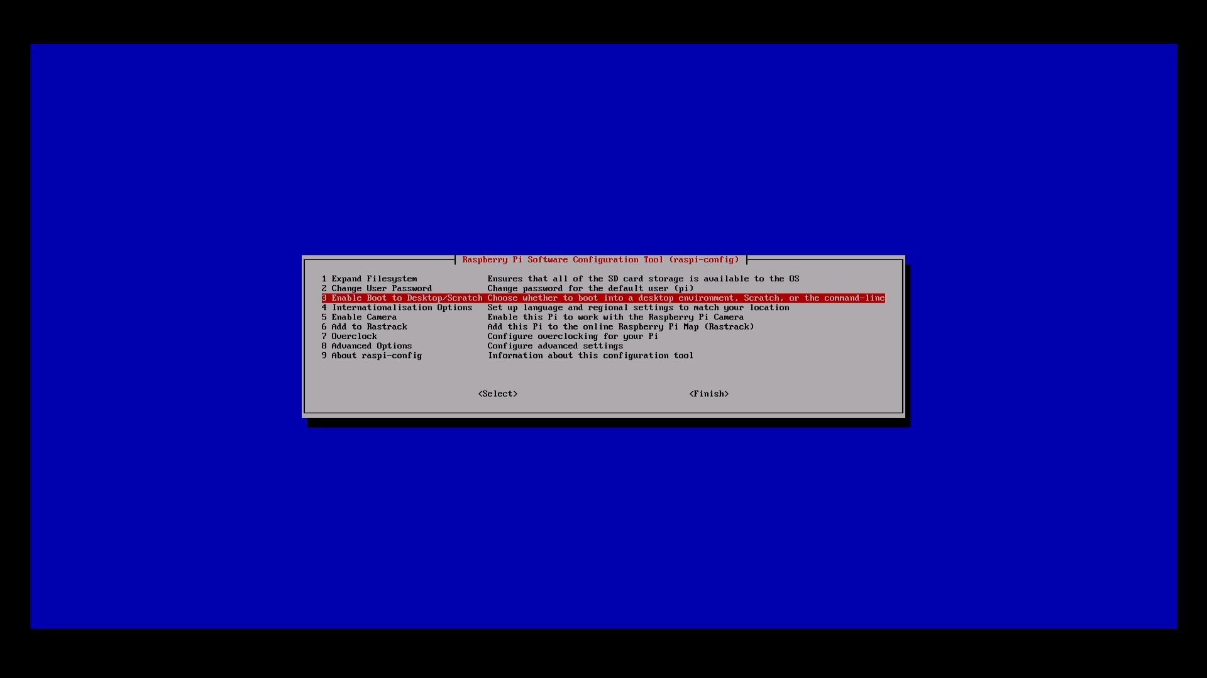
Boot desktop options

Slide 13
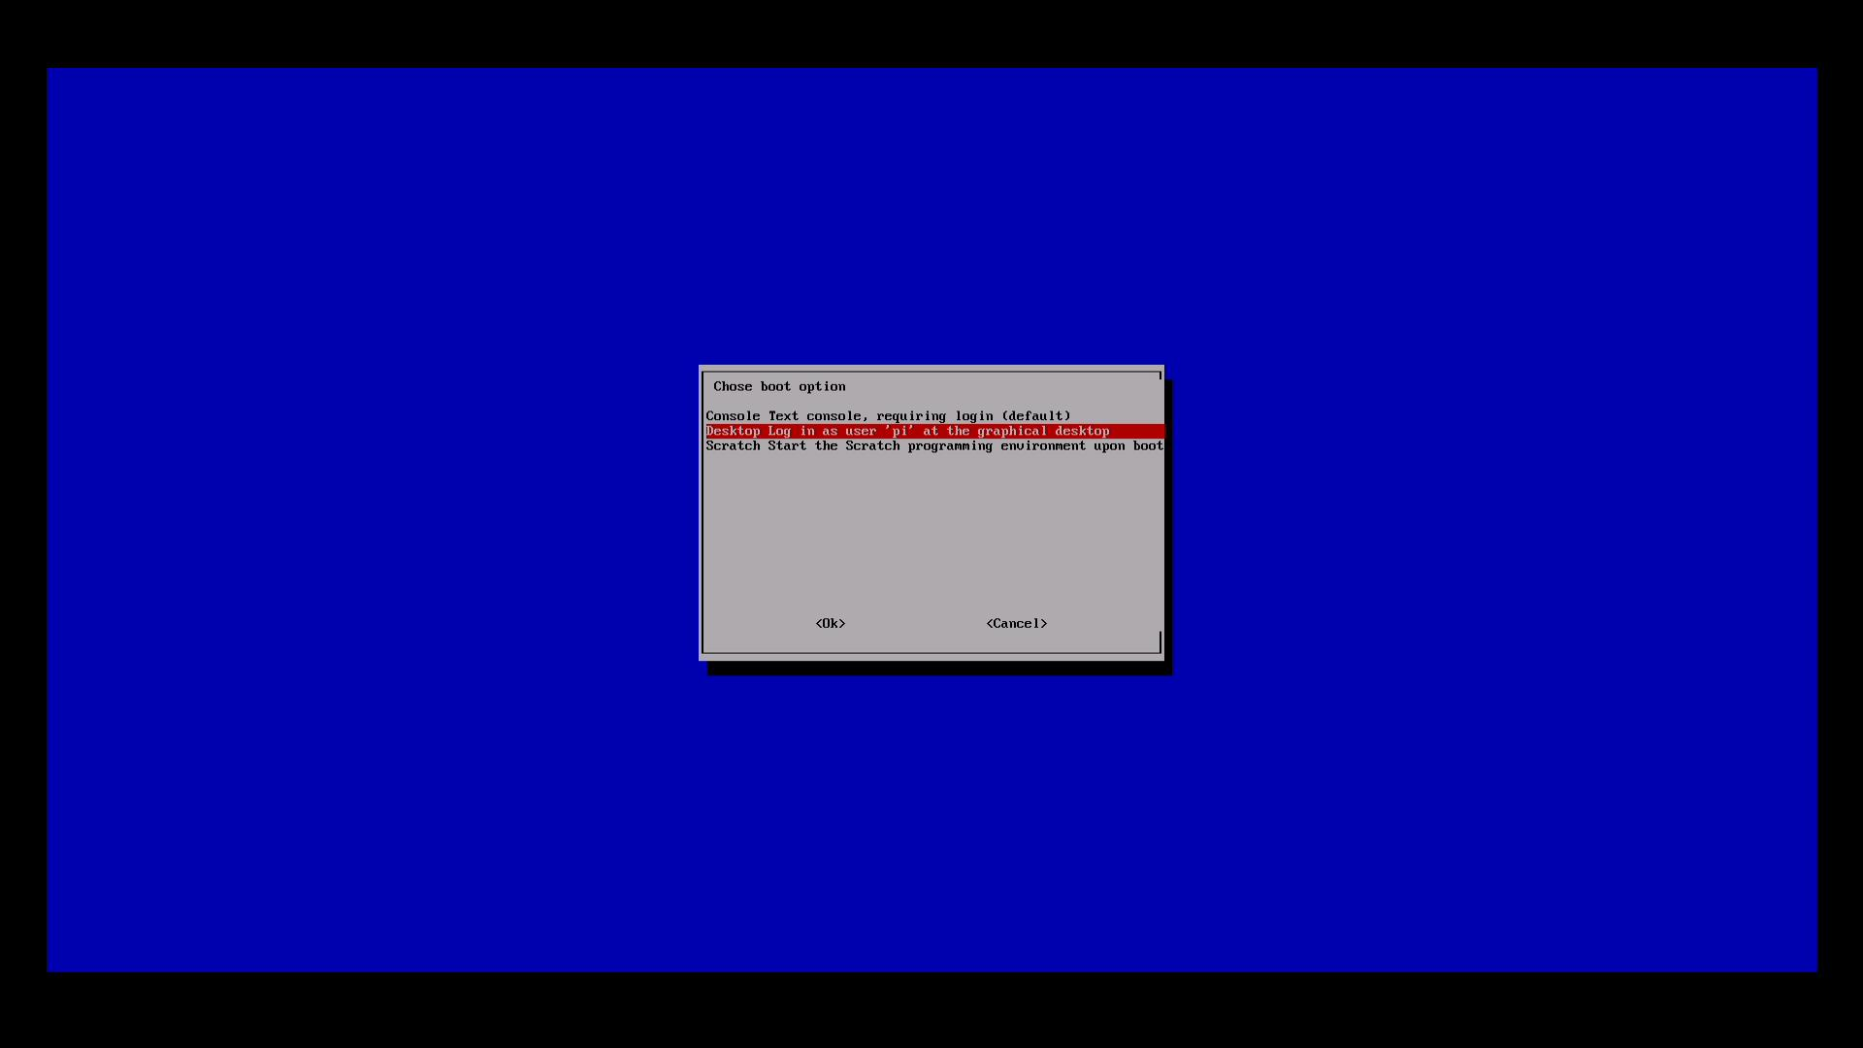
Select graphical option

Slide 14
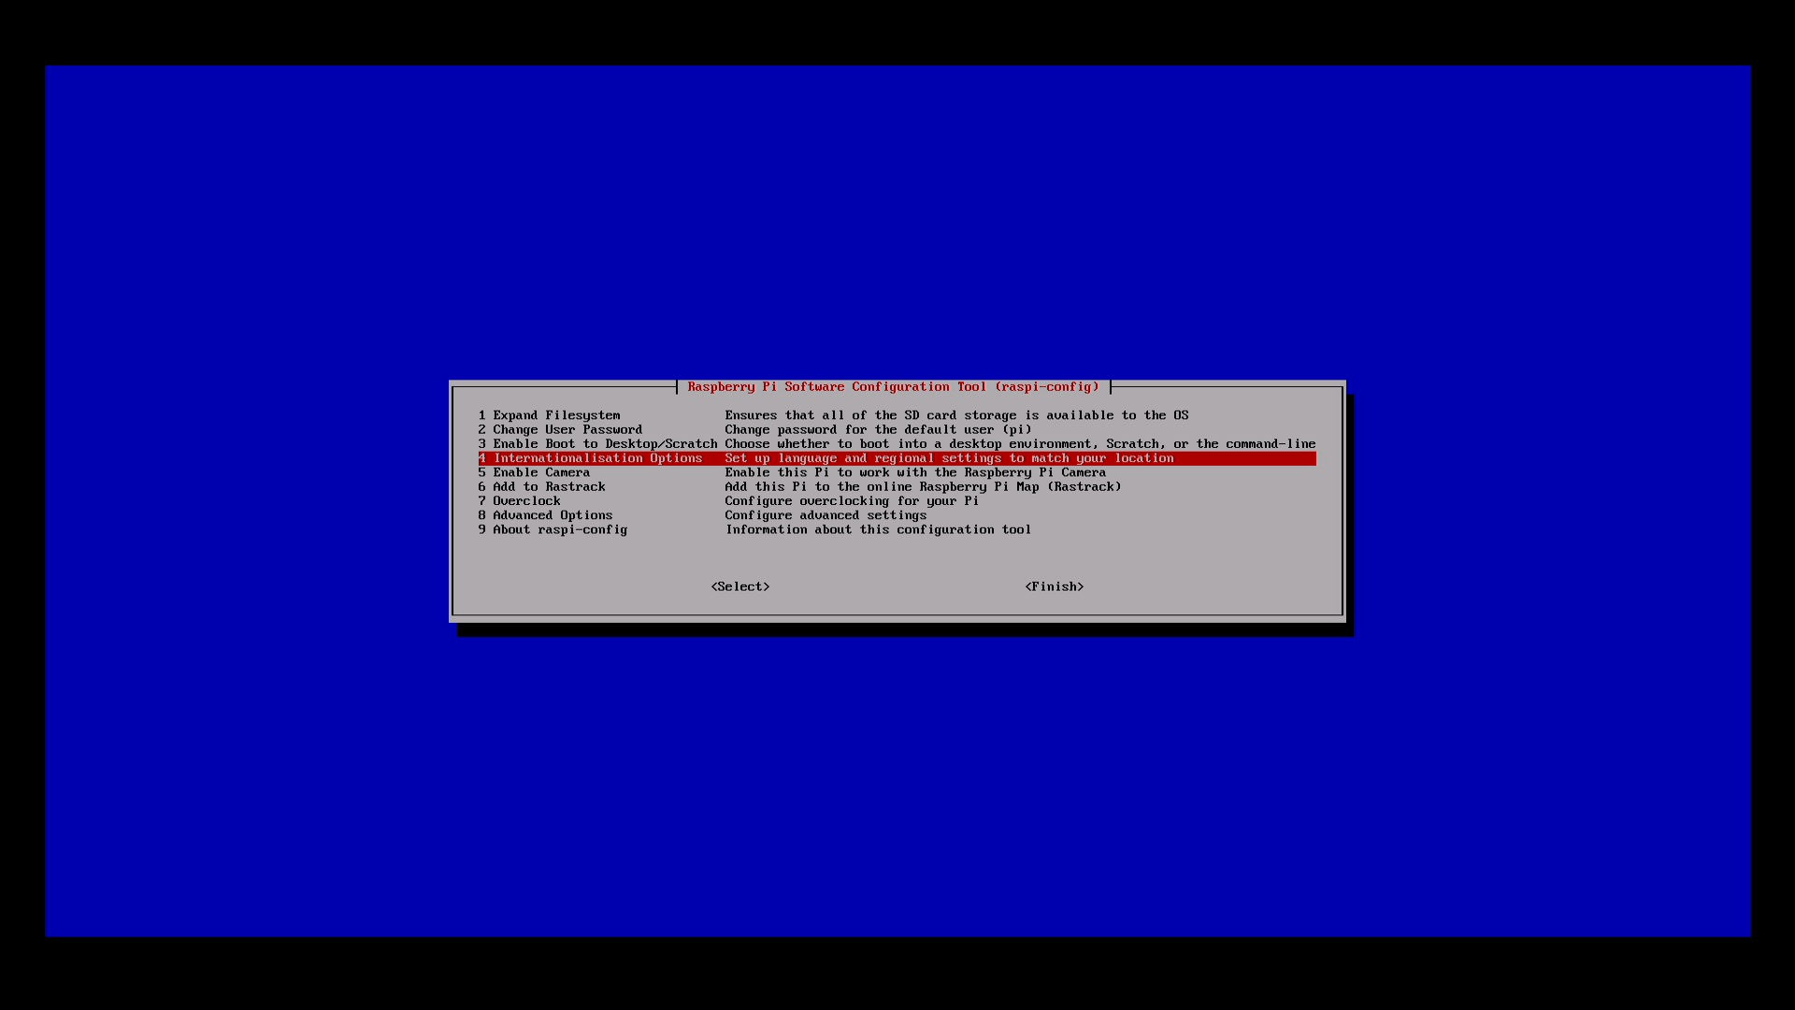
Internationalisation options

Slide 15
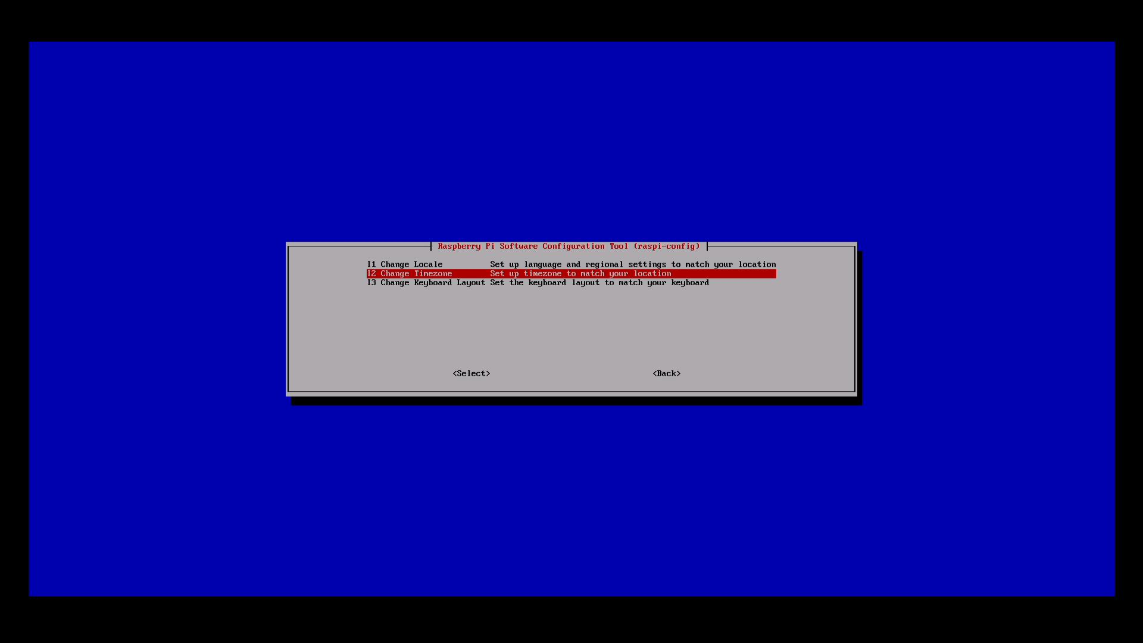
Change timezone

Slide 16
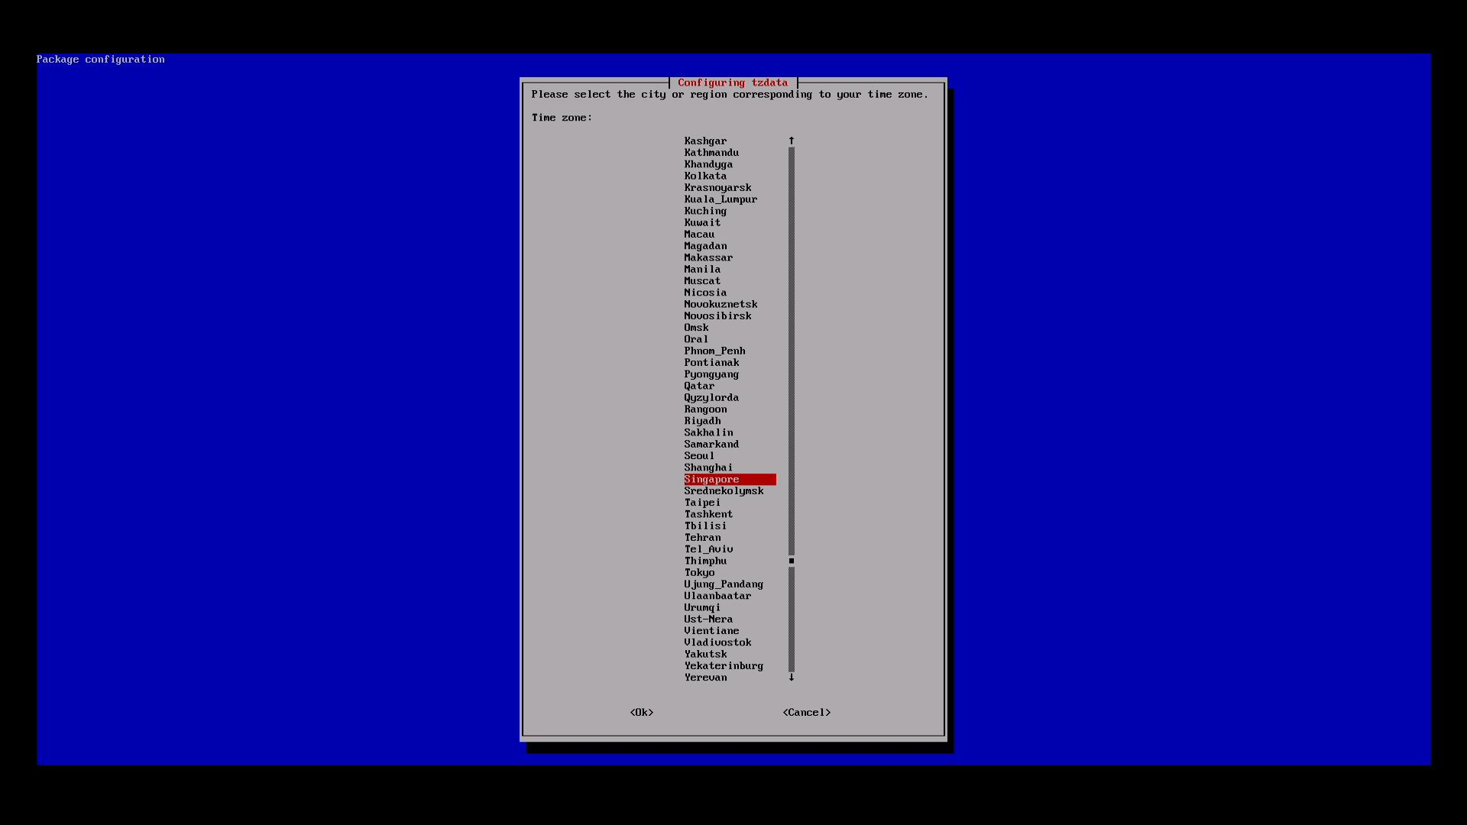
Select Asia/Singapore timezone

Slide 17
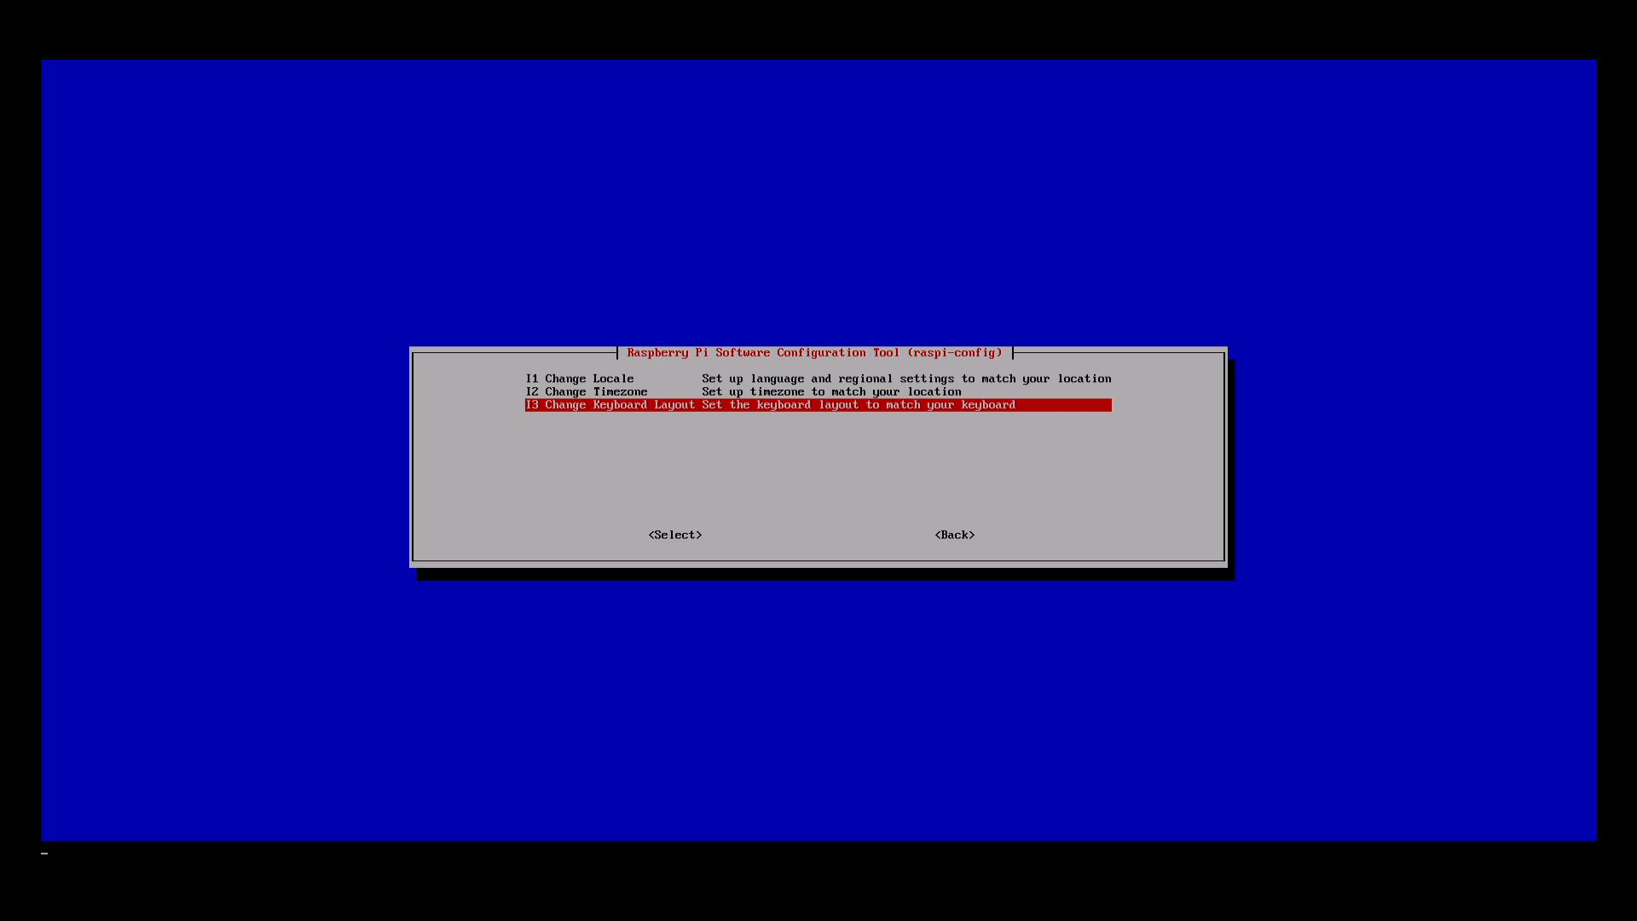
Change keyboard layout

Slide 18
Change to English (US) layout
We don’t want the default UK layout
-> Generic 105-key (intl) PC
-> Other
-> English (US)
-> English (US)
-> The default keyboard layout
-> No compose key
-> “Yes” to terminate X server

Slide 19

Enable camera (optional)

Slide 20
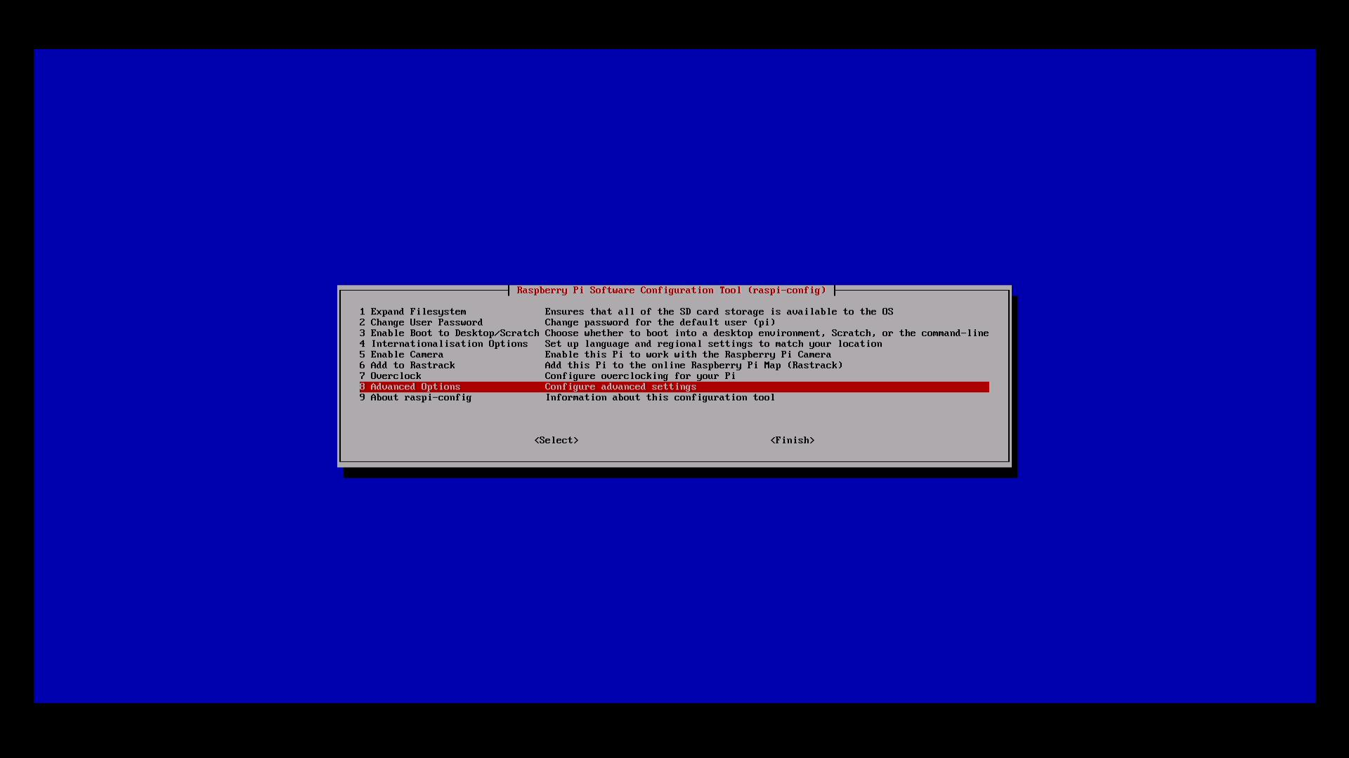
Advanced Options

Slide 21
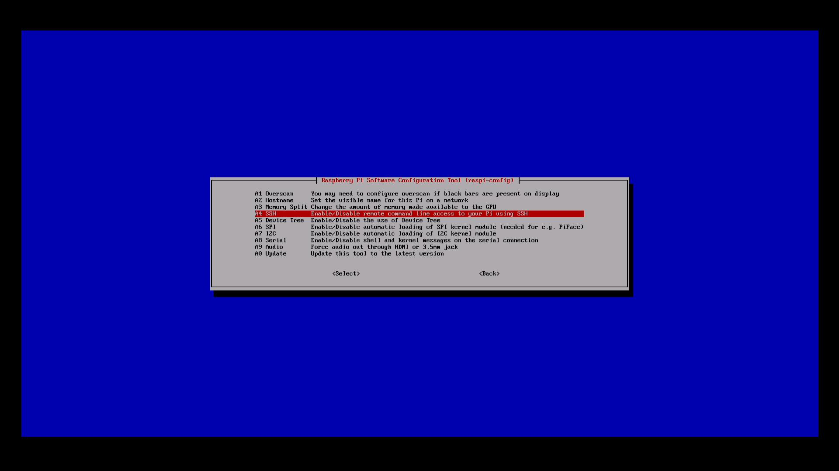
Enable SSH (remote access)

Slide 22
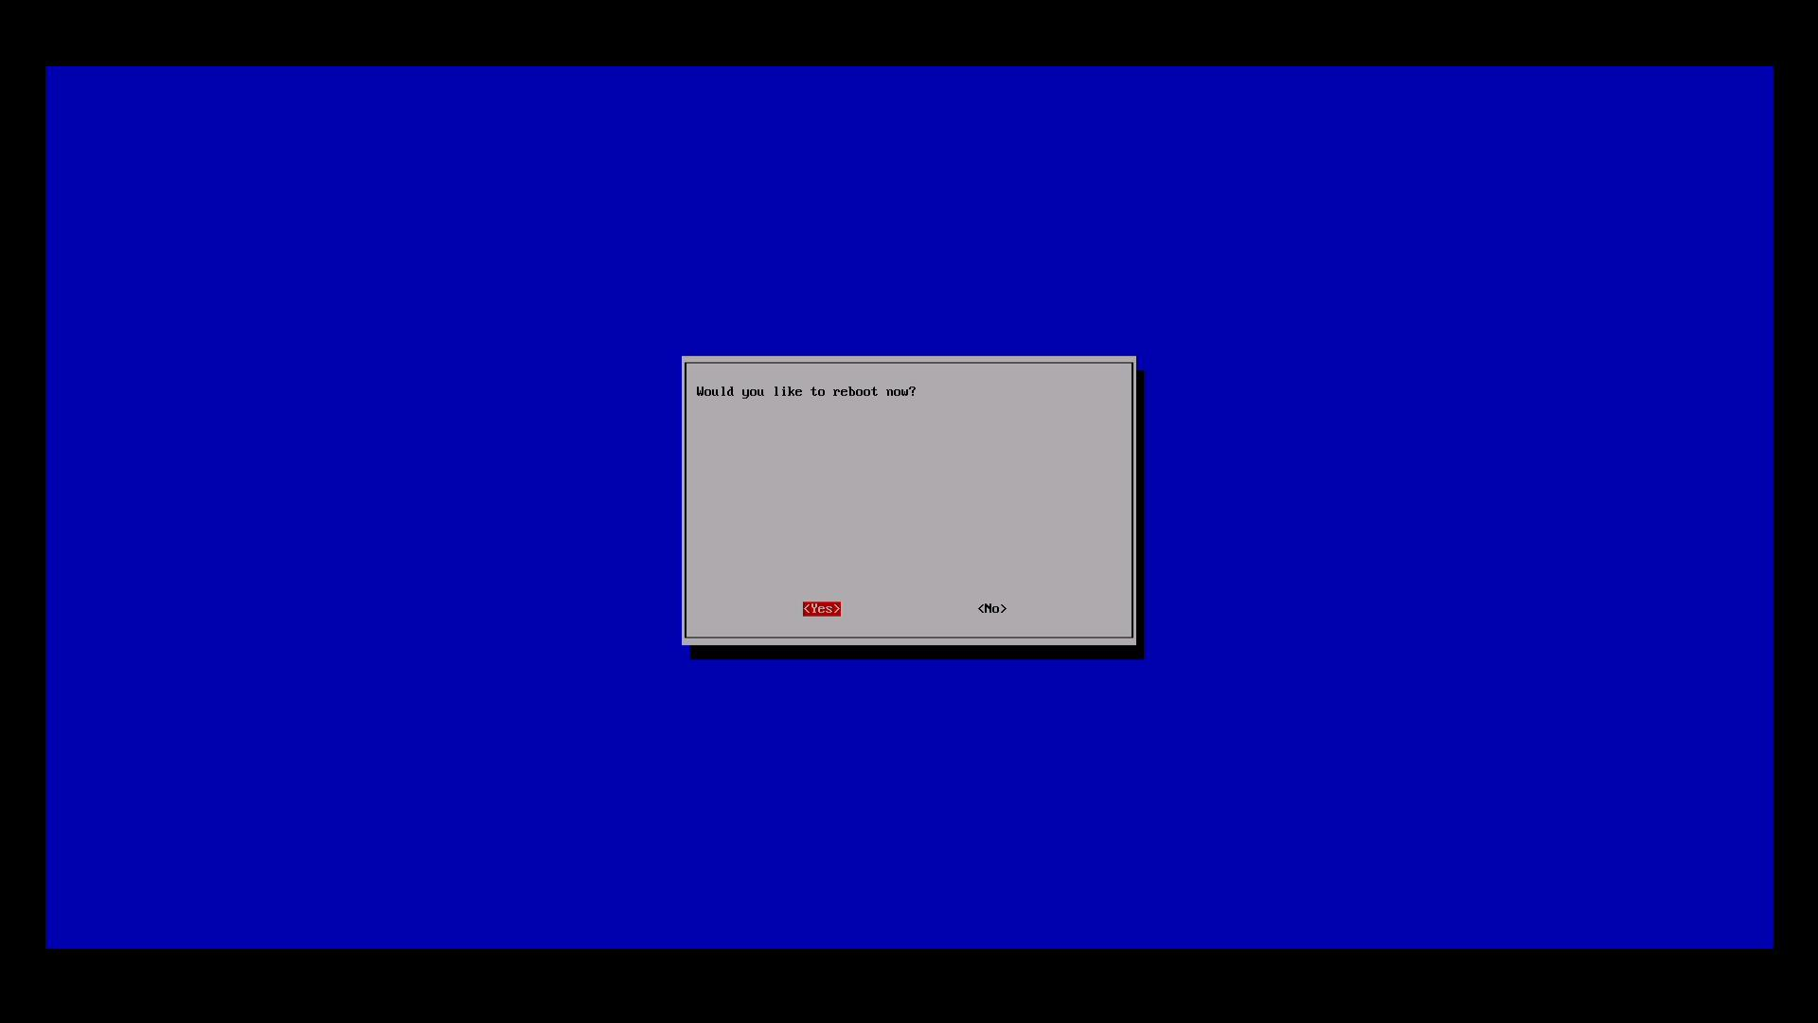
Reboot when complete

Slide 23
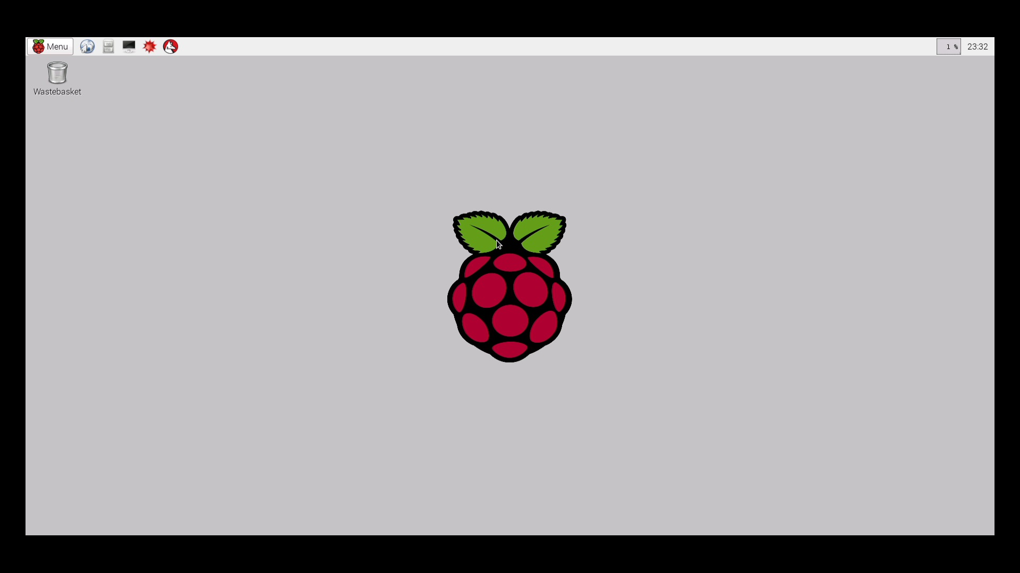
Initial setup complete!

Slide 24
SSH connection and terminal
Use “ifconfig” to get IP address
ifconfig
Look under “eth0”
Windows
Putty: Hostname: x.x.x.x, Port: 22
Mac/Linux
Open terminal
ssh pi@x.x.x.x

Slide 25
Raspbian default username/password
Username: pi
Password: raspberry

Slide 26
Unix basics
Show directory contents:
(Do this after every command below to see what has changed)
ls or ls -l
Make directory:
mkdir lesson
Change directory:
cd lesson
Create an empty file:
touch myfile
Edit file with nano:
nano myfile
Type something random inside the text editor then press Ctrl+X to save and quit.
View file quickly:
cat myfile
Copy file
cp myfile myfile2
Remove file:
rm myfile
Move file
mv myfile2 myfile

Slide 27
Other useful commands
Command | Purpose
man | Get information about a particular command. Eg: man ls
ifconfig | Get network information like IP address
adduser | Create user
passwd | Change password
uname –a, uname -r | Show OS information
history | Shows past commands you ran
chmod | Change permissions of a file/directory

Slide 28
Multi-user environment: Root vs non-root vs sudo
root (privileges)
One administrative user that can do anything
Most Linux distributions have root by default except for Ubuntu, Raspbian
Required for hardware access, package installation etc
non-root
Only restricted to activities in home (~) directory
sudo
Command to let certain non-root users temporarily get root privileges
Prepend in front of command that needs root
Eg: sudo apt-get install java

Slide 29
Package management
Install software from online repositories
Maintains dependencies for you
All these software come as packages
Firefox, nano, sudo

Slide 30
Using a package manager -installing htop
Always run before package installation
Update local repository index
sudo apt-get update
Upgrade all out-of-date packages
sudo apt-get upgrade
Install htop
sudo apt-get install htop
Htop:
Process information viewer like Windows Task Manager
*Skip this slide if no internet connection

Slide 31
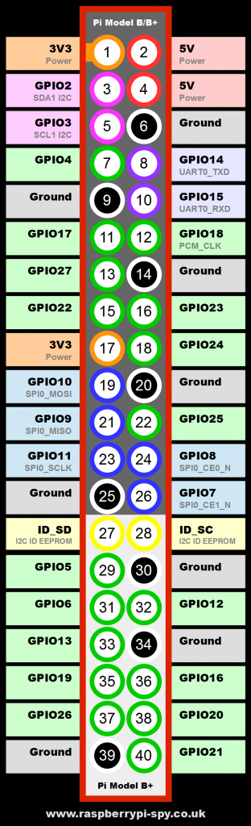
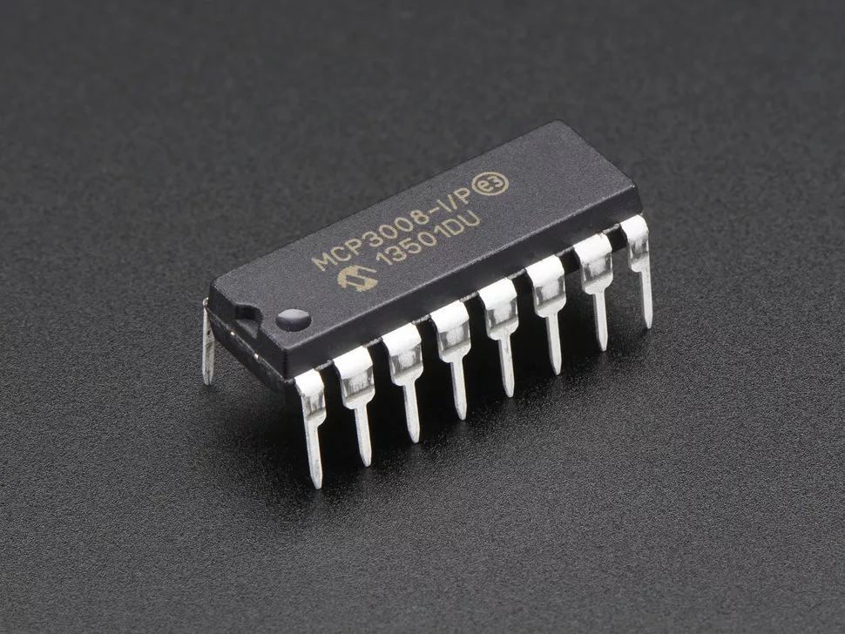
Header pins
26 Digital-only General Purpose Input Output pins
Includes i2C and SPI
3.3V logic levels
No analog-digital-converter
Use external ADC like MCP3008

Slide 32
Using the GPIO pins
Python programming language
LED
Button

Slide 33
Before handling GPIO
Always shut down the Rpi
sudo poweroff
Side note: Unlike the Arduino, Rpi needs to be shutdown properly before pulling the power.

Slide 34
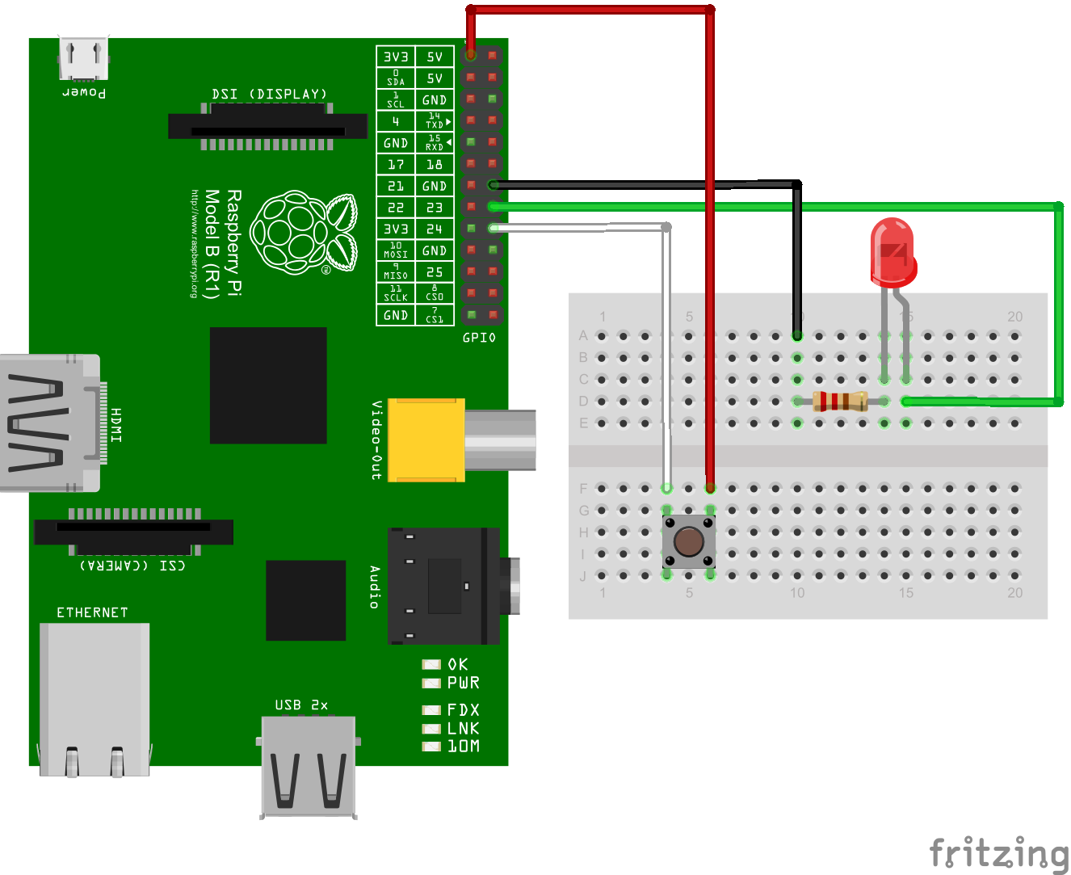
LED and Button Connection

Slide 35
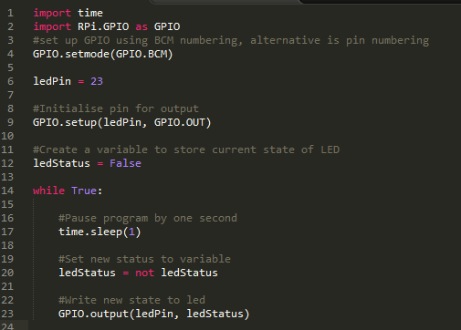
LED code
1. Open command line text editor: nano gpio.py
2. Type the code on the left
3. Quit nano with Ctrl+X
4. Run code: sudo python gpio.py
Result:
LED should blink at 1 second intervals
Watch your indentation. Python is indentation-sensitive

Slide 36
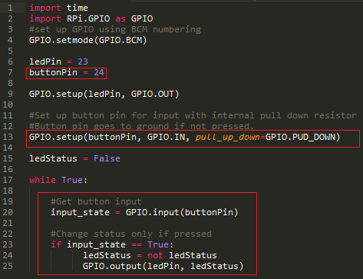
LED and button code 1
1. Quit the previous program using Ctrl+C
2. Modify your previous code:
nano gpio.py
3. Run again:
sudo python gpio.py
Now try pressing the button a few times.
What do you notice? Why?

Slide 37
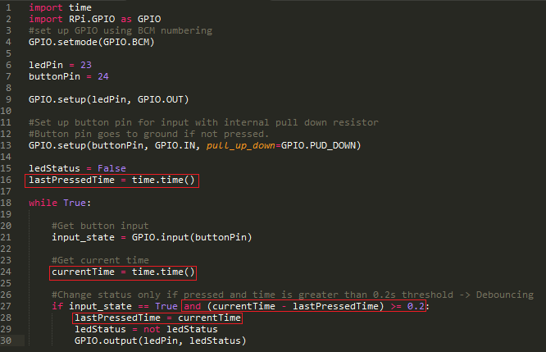
LED and button code 2 (Debouncing)
Does it work properly now?

Slide 38
Now lets use the process viewer
Keep the previous code running
Open another terminal or SSH connection
Run the process viewer
htop
If you did not install htop: “ps aux | grep python”
What do you notice about Python’s CPU usage? Why?

Slide 39
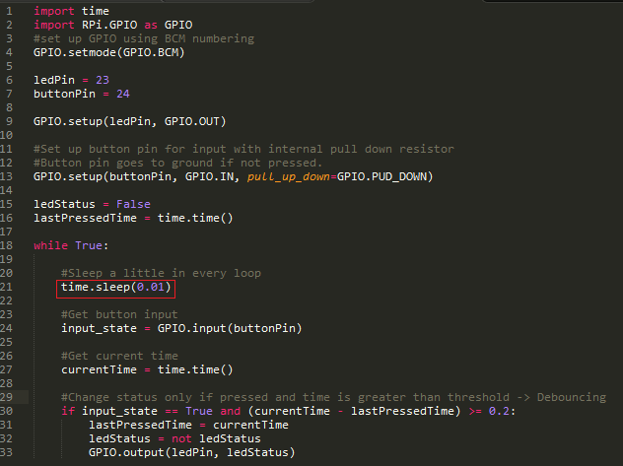
LED and button code 3 (Avoid high CPU consumption)
What is Python’s CPU usage now?

Slide 40
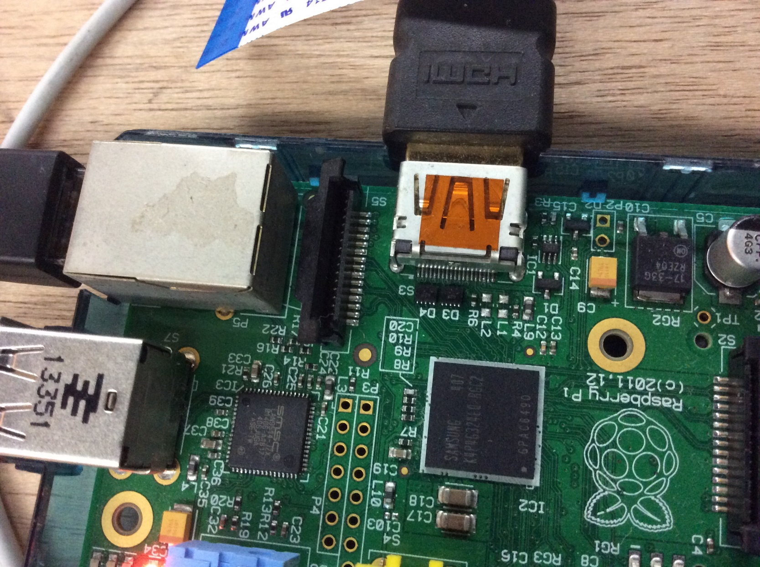
Camera hardware connection
1. Lift up the top connector

Slide 41
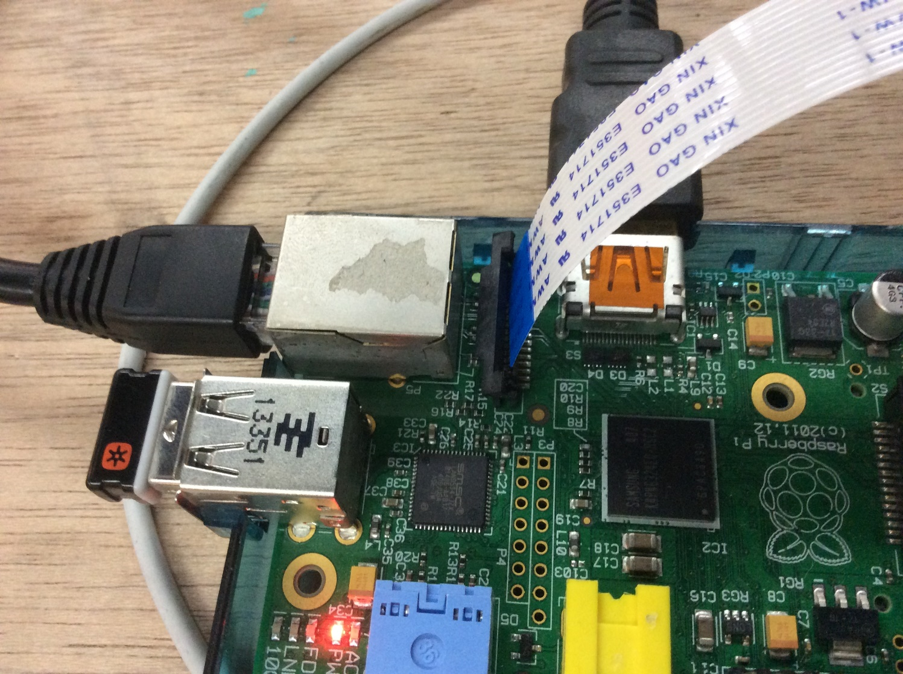
Camera hardware connection
2. Insert the Flexible Flat Cable (FFC), note the position of the blue strip.

Slide 42
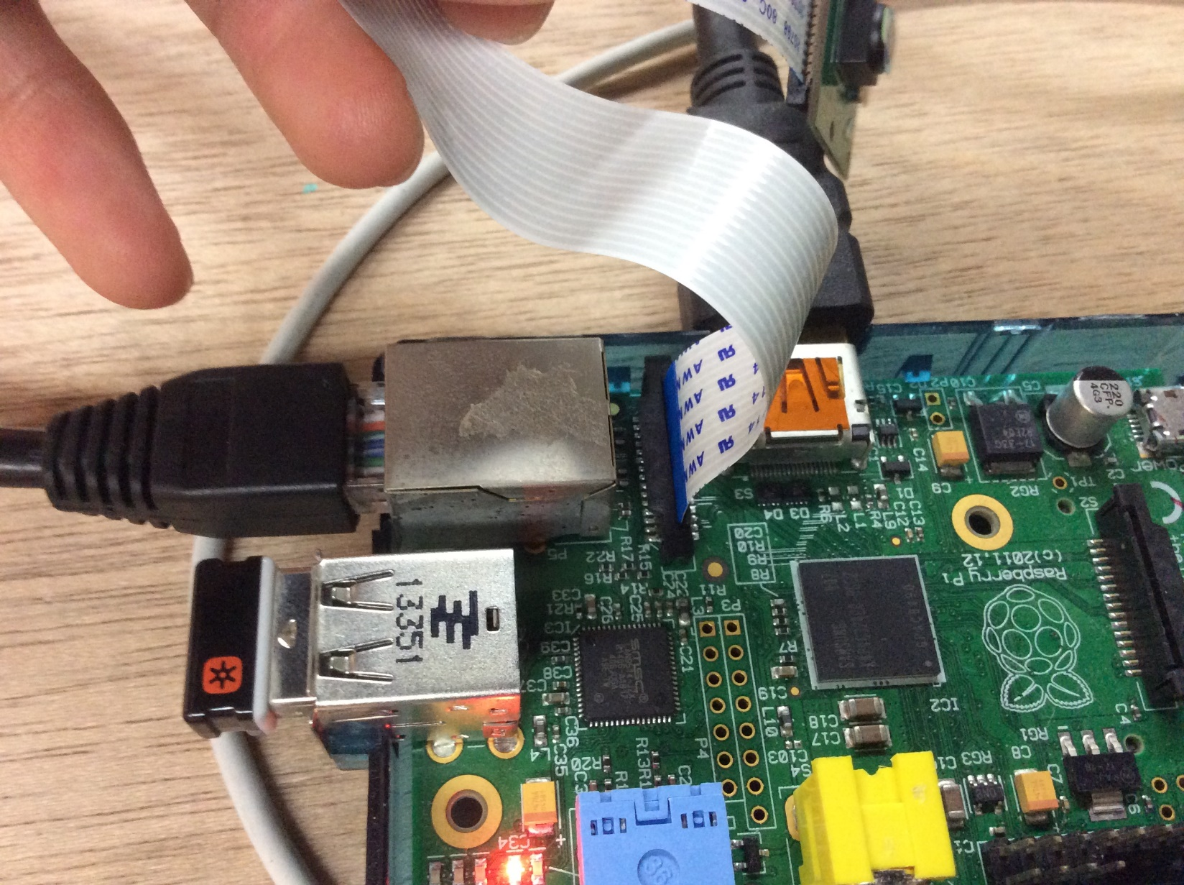
Camera hardware connection
3. Lock the connector back

Slide 43
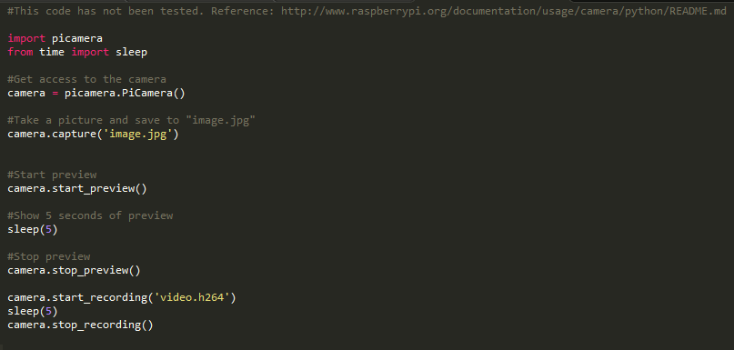
Python camera code

Slide 44
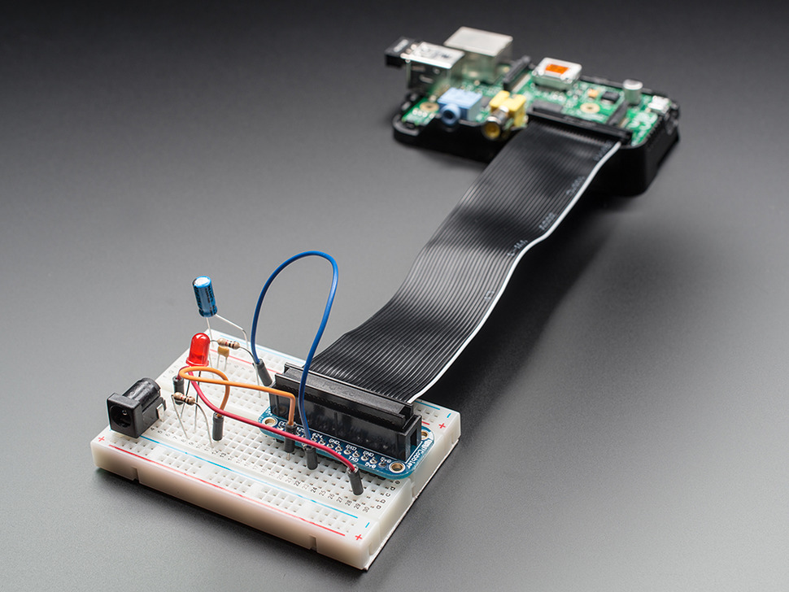
Some useful addons
Cobbler
Case
USB-TTL cable

Slide 45
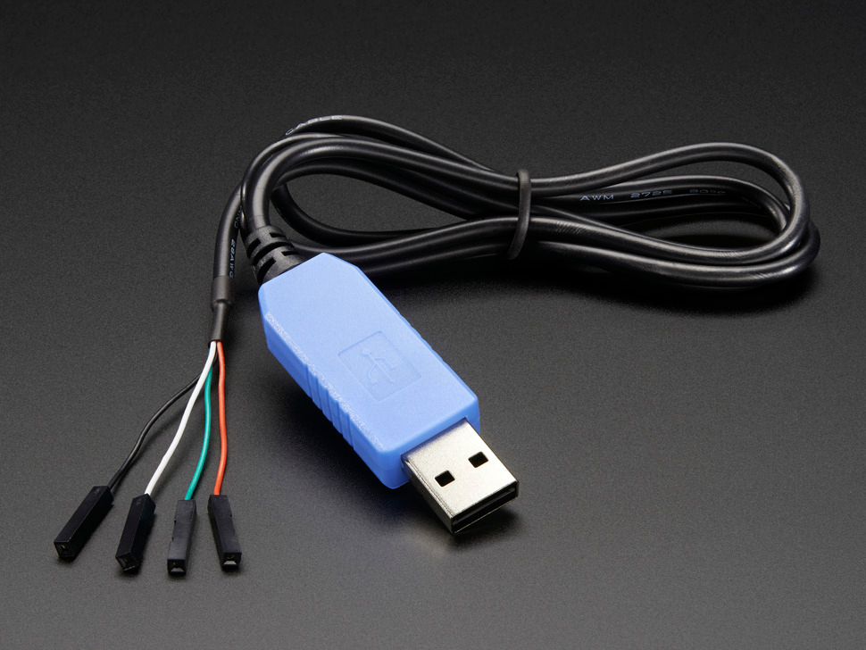
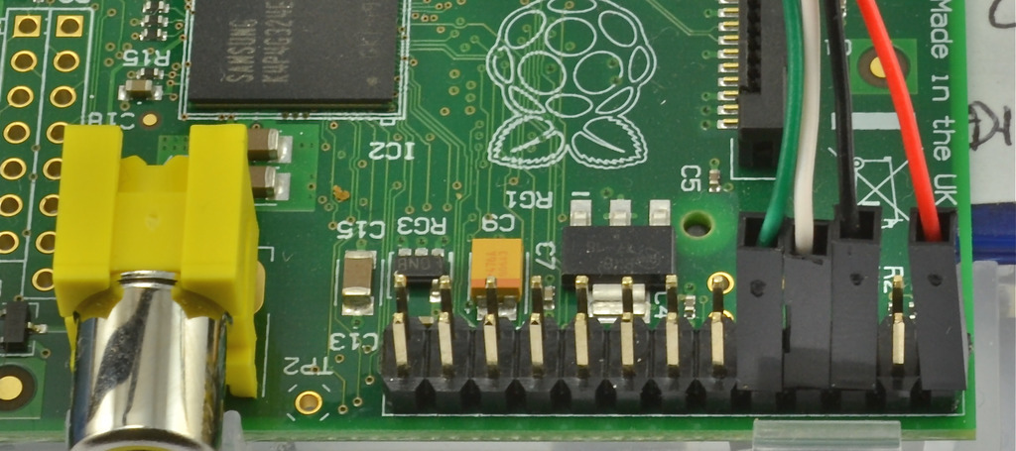
3.3V USB-TTL cable
An alternative way of interacting with your Rpi without keyboard and HDMI screen
https://www.adafruit.com/product/954
Windows
Check COM number n from Device Manager
Putty, Serial COMn, Speed 115200
Mac/Linux
Install screen
Linux: screen /dev/ttyUSB0 115200
Mac: screen /dev/tty.usbserial 115200

Slide 46
Sharing SD cards between Rpi 2 and others
May not always be swappable
Some distributions like Arch Linux have ARMv7 specific packages
No issue with Raspbian as of now

Slide 47
Further reading
GPIO interrupts
Other RPi operating systems like Arch Linux ARM
Read-only file system if you need unsafe poweroff
Mini-UPS for unsafe power off

Slide 48
Q&A

